Slide 1

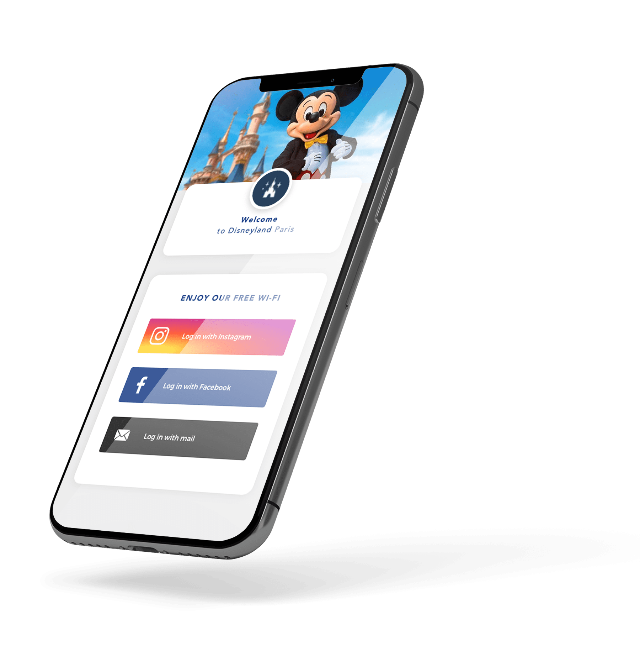

Quarterly meeting #2
June 19, to June 20, 2024

Slide 2
Agenda
Wednesday the 19th
12:00-14:00 : Lunch in the Conservatory
14:00-14:15: Corporate Presentation
14:15-14:45: Sales Updates
14:45-15:15: Product/Tech
15:30-17:00: Meets Up - with Jean-Christophe, Souleymane & Gérald
17:00-17:30:
18:00:
Thursday the 20th
10:00-11:00: Wifi regulation & GDPR refresher's course by Océane
11:00-12:00: Group photo and individual in the Conservatory
12:00-13:30:Lunch in the Conservatory
13:30-14:30: Group photo and individual in the Conservatory
14:30-18:00: Free Meetings

